Slide 1
PROJECT RAPTORS REBOUND
DAT 205 Capstone
Group 1 - Bhavika Patil, Cindy Guo, Dennis Hung
Notes:
Good evening Everyone,
Today, we Group 1; Myself – Bhavika, Cindy and Dennis are going to present the progress we have made on our Project RAPTORS REBOUND
[NEXT SLIDE]

Slide 2
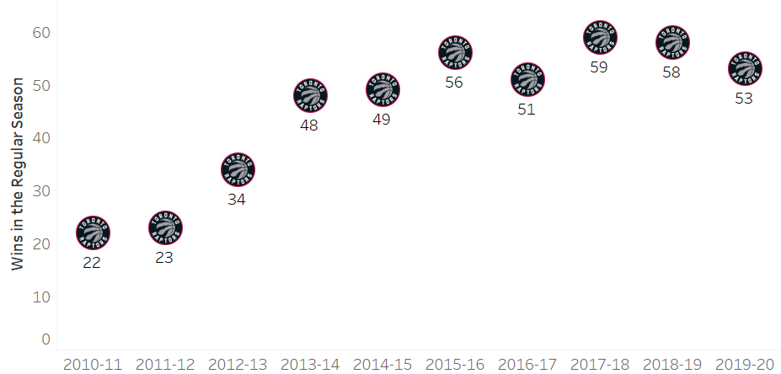
The Client
The Toronto Raptors are an NBA championship team with a USD2.1 billion market capitalization in 2020.
The team’s General Manager (GM) and owners are seeking recommendations on improving the team’s chances at another championship run while preserving the team’s long-term future.
TORONTO RAPTORS
Notes:
The Client
[NEXT 01 – Graph]
Pause for effect
[NEXT 02 – Raptors]
Our client is Toronto Raptors, Currently the only Canadian NBA franchise.
In the year 2020, The Toronto Raptors’ valuation was estimated to be 2.1 billion USD. The raptors won their first NBA Championship in 2019. However, the team’s performance has been in decline since then. This chart shows the wins for each year for the Toronto Raptors.
[NEXT 03 – GM]
The team’s General Manager is seeking recommendations on improving the team’s chances at another championship run while preserving the team’s long-term future. The suggestions will be in the form of improvements to the player roster. The stakeholders intend to either maintain or improve on the number of wins during the regular season and more importantly during the playoffs while retaining the public interest in the team.
[NEXT SLIDE]

Slide 3
Objectives
The primary objective: To determine which features are important to TOR to produce more wins
The secondary objective: To review team players’ performance-to-cost effectiveness
Notes:
To attain the requirements outlined by the management, we have set 2 objectives. we are looking to determine what features affect team wins/losses and predict how they can be improved/reduced through changes in the team’s roster.
1. The primary objective of this analysis is to determine which features are important to the Toronto Raptors team to produce more wins in the regular season and the playoffs.
2. The secondary objective is to review team players’ performance-to-cost effectiveness.
The scope of this analysis will be to focus on the historical player data from 2005 to 2020 as this closely represents the players of the current era. The performance baseline of the team and players will be established using the data for the Toronto Raptors 2019-2020 season. These statistics will be used to indicate performance features for the team and the individual players.
To simplify the analysis, the following assumptions were made:
Changes are only applied to the Toronto Raptors; the statistics from other teams are not affected or changed.
Obtaining any players is up to the Toronto GM to determine if they will pursue the player via free agency, trading of players, etc.
To attain the requirements outlined by the management, we are looking at two objectives
[NEXT 01 – Primary Objective]
The primary objective of this analysis is to determine which features are important to the team to produce more wins in the regular season and the playoffs.
[NEXT 02 - Secondary Objective]
The secondary objective is to review team players’ performance-to-cost effectiveness.
[NEXT 03 – Data scope]
The scope of the initial analysis will be to focus on the Toronto Raptors’ historical player data from 2005 to 2020 as this closely represents the players of the current era. The performance baseline of the team and players will be established using the data for The Toronto Raptors 2019-2020 season. These statistics will be used to indicate performance features for the team and the individual players.
[NEXT SLIDE]

Slide 4
Data
PlayerGameLogs
Open access API (nba_api)
Total ~450K records, 36 features
NBA Player Salaries
ESPN for the historical data
Hoopshype for future data
489 records
Notes:
Data description
Data cleansing, if needed – steps taken – what were the challenges with the data and steps taken to cleanse bring it to usable format (ETL – extract, transform, load steps). Technology/tools used for cleansing/analysis
Methods (methods, relevant outputs)
The data collection for this analysis was a cumbersome process. We have used multiple sources to gather the data.
[NEXT 01 – API]
nba_api is an open access API client library for Python requesting the data via webservices through stats.nba.com. We are using 2 endpoints.
[NEXT 02 – Player Game Logs]
playgamelogs fetches player statistics for each game. This dataset consists of more than 450k rows. We are using 36 features. It has 15K records for the Toronto Raptors alone. We are only showing a few features here, this dataset acts as the main datasource for the analysis.
[NEXT 03 – Play by Play]
PlayByPlay gets all activities for a game, we fetched stats for all games derived from the first Dataset. This dataset has about 10M records and can reference the main dataset by GAME_ID.
[NEXT 04 – Player salaries]
NBA webservice does not provide the salary data. Historical salary data was drawn from ESPN website and the future salary data from HoopsHype website. These were obtained using web scraping in python. We are looking at current 489 NBA players. We can relate this table to the Playergamelogs using the Player name and the Season year.
[Just pause for a couple of seconds]
This diagram is created only for easy understanding of the schema. Since this is not a normalized database; which would be very expensive for this analysis, the relationship keys are not enforced by any constraint.
[Next speaker handoff statement]
Now I shall hand over to Dennis
[NEXT SLIDE]

Slide 5
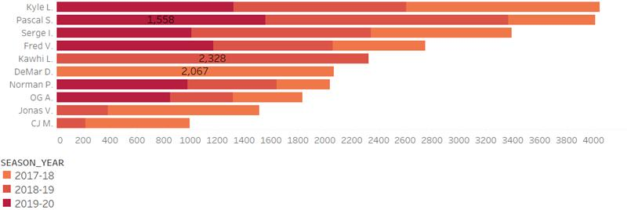
Initial Analysis
Top 10 Toronto Raptors Players by Points for the Seasons 2017-2020
Notes:
[NEXT 01 – Top 10 Toronto Raptors Players by points for the past 3 Seasons]
Let’s talk about who scored the most points in the last 3 seasons.
[NEXT 02 – Graph]
In this graph, it shows the top 10 players and their points. The horizontal axis is the total points scored in the last 3 seasons. The vertical axis is the player names.
We only study the players who scored at least 100 points in both Regular and Playoffs. The different color on the stack bar is for the different seasons. The darker color indicates the recent season vs lighter color for old seasons. Some players may have contracts with Raptors for only one season, we will see only one color on the stack bar.
[NEXT 03 – DeMar]
In 2017-18 season, DeMar was No. 1 with 2067 points.
[NEXT 04 – Kawhi]
In 2018-19 season, Kawhi had the highest score with 2328 points.
[NEXT 05 – Pascal]
In 2019-20 season, Pascal Ranked No. 1 with 1558 points.
[NEXT 06 – Kyle]
In all 3 seasons, Kyle scored the highest points and followed by Pascal.
[Next speaker handoff statement]
Now I shall hand off back to Dennis
[NEXT SLIDE]

Slide 6
Data Analysis – Phase 1
Phase 1 – Feature Selection
PlayerGameLogs Data
Add features
“Game_Type” and “Salary”
Data
Cleaning
Data Enhancements:
Calculate Advance Statistics
(PIE and PER)
Prepare data by
Season type
Define Target
variable
Transform
Categorical
variables
Remove irrelevant
features
Filter data to
Toronto Raptors
Drop the features
which are strongly
correlated
Build
models
Find 3 Top
Important features
Compare and select the
best model
Notes:
Talk and move through the boxes but in groupings (ie boxing the transformation
Box 1-2 ETL
Box 3-7 Data enhancement/transformation
Box 8-10 Preparation for modeling
Box 11-13 Analysis
This analysis was done in 2 phases:
The data collection for this analysis was a cumbersome process. We have used multiple sources to gather the data.
[NEXT 01 – API]
nba_api is an open access API client library for Python requesting the data via webservices through stats.nba.com. We are using 2 endpoints.
[NEXT 02 – Player Game Logs]
playgamelogs fetches player statistics for each game. This dataset consists of more than 450k rows. We are using 36 features. It has 15K records for the Toronto Raptors alone. We are only showing a few features here, this dataset acts as the main datasource for the analysis.
[NEXT 03 – Play by Play]
PlayByPlay gets all activities for a game, we fetched stats for all games derived from the first Dataset. This dataset has about 10M records and can reference the main dataset by GAME_ID.
[NEXT 04 – Player salaries]
NBA webservice does not provide the salary data. Historical salary data was drawn from ESPN website and the future salary data from HoopsHype website. These were obtained using web scraping in python. We are looking at current 489 NBA players. We can relate this table to the Playergamelogs using the Player name and the Season year.
[Just pause for a couple of seconds]
This diagram is created only for easy understanding of the schema. Since this is not a normalized database; which would be very expensive for this analysis, the relationship keys are not enforced by any constraint.
[Next speaker handoff statement]
Now I shall hand over to Dennis
[NEXT SLIDE]

Slide 7
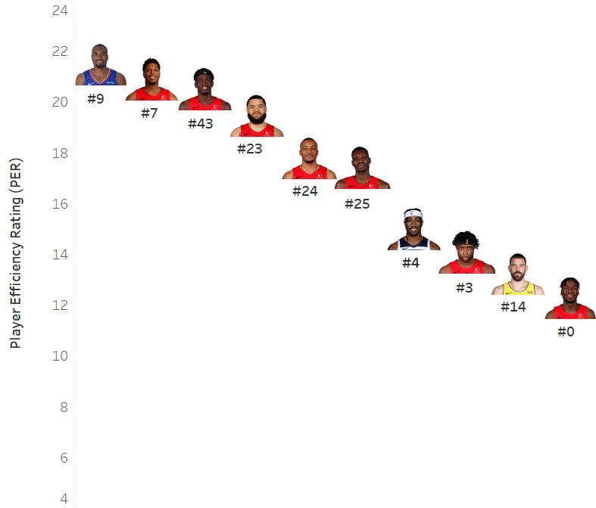
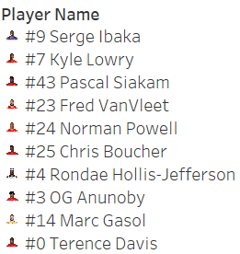
Advance Stats - PER
Top 10 Toronto Raptors Player Efficiency Rating (PER) for Season Year 2019-20
PER=[ FGM x 85.910 + Steals x 53.897+ 3PTM x 51.757 + FTM x 46.845 + Blocks x 39.190 + Offensive_Reb x 39.190 + Assists x 34.677
+ Defensive_Reb x 14.707 - Foul x 17.174 - FT_Miss x 20.091 - FG_Miss x 39.190- TO x 53.897 ] x (1 / Minutes)
Notes:
[Cindy to take over]
Thank you, Bhavika. I will continue on to the next part of Initial Analysis.
[NEXT 01 – The slide is to show the topic for our study]
First, we determine the most efficient players for Toronto Raptors in the season 2019-20. The Player Efficiency Rating (PER) is introduced in our analysis.
PER is John Hollinger's all-in-one basketball rating, which attempts to boil down all of a player's contributions into one number. Here is the formula.
[NEXT 02 – The slide is to show the formula]
PER takes into account accomplishments, such as field goals, free throws, 3-pointers, assists, rebounds, blocks and steals, and negative results, such as missed shots, turnovers and personal fouls. The formula adds positive stats and subtracts negative ones through a statistical point value system. The rating for each player is then adjusted to a per-minute basis.
There are other PER formulas as well which may be different from the one we use.
[NEXT 03 – Player Performance Graph]
This graph shows the top 10 Player Efficiency Rating for Toronto Raptors in the Season 2019-20. The horizontal axis is the player names. The vertical axis is the PER number for each player. The analysis includes both Regular and Playoffs.
[NEXT 04 – Jersey]
The Jersey number is highlighted for each player under the photo.
[NEXT 05 – Serge]
From the PER calculation, Serge ranked No.1 in the season 2019-20 with a value of 21.50.
[NEXT SLIDE]
Then, we calculated Player Impact Estimate (PIE) value. The PIE formula compiles everything a single player does in a game -- points scored, rebounds, blocks, missed free throws etc. -- and weighs that number against the same stats generated by everyone in that same game.
Here is the formula.
This graph shows the top 10 Player Impact Estimate for Toronto Raptors in the Season 2019-20. The horizontal axis is the player names. The vertical axis is the PIE number for each player. The analysis includes both Regular and Playoffs.
From the PIE chart, Kyle had the highest PIE with a value of 17.9.

Slide 8
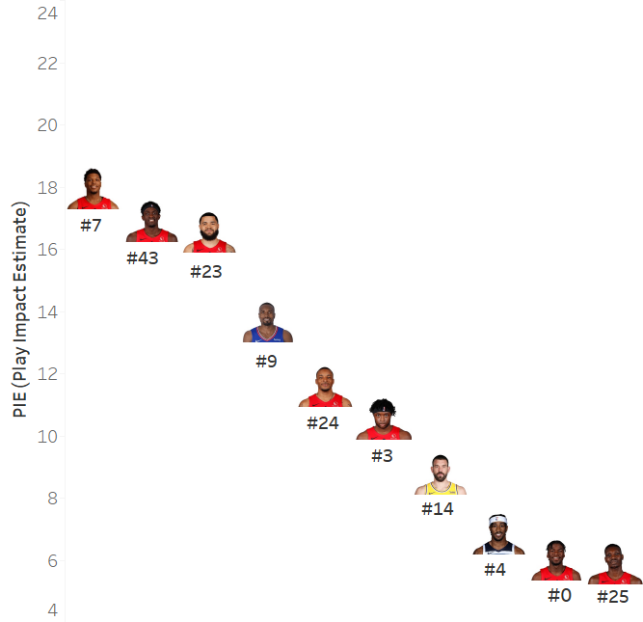
Advance Stats - PIE
Top 10 Toronto Raptors Player Impact Estimate (PIE) for Season Year 2019-20
PIE = [PTS + FGM + FTM - FGA - FTA + DREB + (0.5 * OREB) + AST + STL + (0.5 * BLK) - PF – TOV] / [GmPTS + GmFGM + GmFTM – GmFGA
- GmFTA + GmDREB + (0.5 * GmOREB) + GmAST + GmSTL + (0.5 * GmBLK) - GmPF – GmTOV]
Notes:
[Cindy to take over]
Thank you, Bhavika. I will continue on to the next part of Initial Analysis.
[NEXT 01 – The slide is to show the topic for our study]
First, we determine the most efficient players for Toronto Raptors in the season 2019-20. The Player Efficiency Rating (PER) is introduced in our analysis.
PER is John Hollinger's all-in-one basketball rating, which attempts to boil down all of a player's contributions into one number. Here is the formula.
[NEXT 02 – The slide is to show the formula]
PER takes into account accomplishments, such as field goals, free throws, 3-pointers, assists, rebounds, blocks and steals, and negative results, such as missed shots, turnovers and personal fouls. The formula adds positive stats and subtracts negative ones through a statistical point value system. The rating for each player is then adjusted to a per-minute basis.
There are other PER formulas as well which may be different from the one we use.
[NEXT 03 – Player Performance Graph]
This graph shows the top 10 Player Efficiency Rating for Toronto Raptors in the Season 2019-20. The horizontal axis is the player names. The vertical axis is the PER number for each player. The analysis includes both Regular and Playoffs.
[NEXT 04 – Jersey]
The Jersey number is highlighted for each player under the photo.
[NEXT 05 – Serge]
From the PER calculation, Serge ranked No.1 in the season 2019-20 with a value of 21.50.
[NEXT SLIDE]
Then, we calculated Player Impact Estimate (PIE) value. The PIE formula compiles everything a single player does in a game -- points scored, rebounds, blocks, missed free throws etc. -- and weighs that number against the same stats generated by everyone in that same game.
Here is the formula.
This graph shows the top 10 Player Impact Estimate for Toronto Raptors in the Season 2019-20. The horizontal axis is the player names. The vertical axis is the PIE number for each player. The analysis includes both Regular and Playoffs.
From the PIE chart, Kyle had the highest PIE with a value of 17.9.

Slide 9
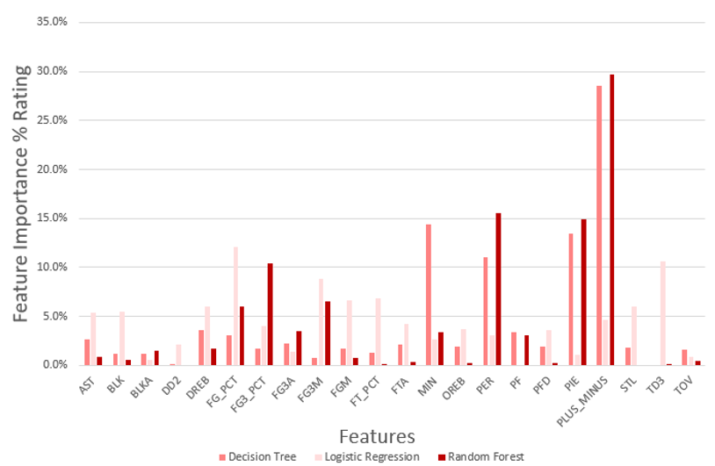
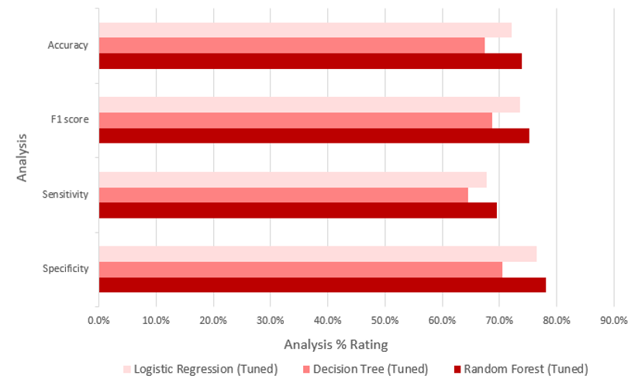
Data Analysis Results – Phase 1
Analysis Comparison by Model
Feature Comparison by Model
Notes:
[Next speaker - Dennis]
For our player analysis, we compared the performance of these 3 models (Logistic Regression, Decision Tree, Random Forest) to 4 metrics:
[NEXT 01 - show graph]
Accuracy – How well the model make True predictions
F1-Score - How well the model make Negative predictions
Sensitivity - The test of confirming True Positives.
Specificity – The test of confirming True Negatives
When comparing the 3 different models,
[NEXT 02 – Focus on RF results]
Random Forest was the best scoring in the 70% range which is good.
Next we determined the feature importance for the 3 models.
[NEXT 03 – Graph - Feature Importance]
Focusing on Random Forest
[NEXT 04 – Focus on model legend]
We find that 60% of the important are covered by these 3 features
[NEXT 05 – Plus/Minus]
Plus/Minus
[NEXT 06 – PER]
Player Efficiency Rating (PER)
[NEXT 07 – PIE]
And Player Impact Estimate (PIE)
With this knowledge we can proceed with out next phase
[Next speaker handoff - Bhavika]
[NEXT SLIDE]

Slide 10
Data Analysis Results – Phase 1
Analysis Comparison by Model
Feature Comparison by Model
Notes:
[Next speaker - Dennis]
For our player analysis, we compared the performance of these 3 models (Logistic Regression, Decision Tree, Random Forest) to 4 metrics:
[NEXT 01 - show graph]
Accuracy – How well the model make True predictions
F1-Score - How well the model make Negative predictions
Sensitivity - The test of confirming True Positives.
Specificity – The test of confirming True Negatives
When comparing the 3 different models,
[NEXT 02 – Focus on RF results]
Random Forest was the best scoring in the 70% range which is good.
Next we determined the feature importance for the 3 models.
[NEXT 03 – Graph - Feature Importance]
Focusing on Random Forest
[NEXT 04 – Focus on model legend]
We find that 60% of the important are covered by these 3 features
[NEXT 05 – Plus/Minus]
Plus/Minus
[NEXT 06 – PER]
Player Efficiency Rating (PER)
[NEXT 07 – PIE]
And Player Impact Estimate (PIE)
With this knowledge we can proceed with out next phase
[Next speaker handoff - Bhavika]
[NEXT SLIDE]

Slide 11
Data Analysis – Phase 2
Phase 2 – Player Selection
Phase 1 – Enhanced Data
(Regular season only)
Find the average
Stats for TOR
for 2014-2020
Establish Player
selection/elimination criteria
Select 3 TOR under-
Performers & 3 Non-TOR
better players
Aggregate Team
data for 2005-2020
Build the new data by
replacing the TOR with
Non-TOR players
Build a Random Forest
Model and save it
Run saved model with the
Generated data
Team Win Prediction
and
Analysis
Notes:
Box 1 Input from Phase 1
Box TD (2-3) Aggregate team data and build model
Box LR (2-5) Player selection
Box Merge (last 2 boxes) Team Win Prediction and analysis
This analysis was done in 2 phases:
The data collection for this analysis was a cumbersome process. We have used multiple sources to gather the data.
[NEXT 01 – API]
nba_api is an open access API client library for Python requesting the data via webservices through stats.nba.com. We are using 2 endpoints.
[NEXT 02 – Player Game Logs]
playgamelogs fetches player statistics for each game. This dataset consists of more than 450k rows. We are using 36 features. It has 15K records for the Toronto Raptors alone. We are only showing a few features here, this dataset acts as the main datasource for the analysis.
[NEXT 03 – Play by Play]
PlayByPlay gets all activities for a game, we fetched stats for all games derived from the first Dataset. This dataset has about 10M records and can reference the main dataset by GAME_ID.
[NEXT 04 – Player salaries]
NBA webservice does not provide the salary data. Historical salary data was drawn from ESPN website and the future salary data from HoopsHype website. These were obtained using web scraping in python. We are looking at current 489 NBA players. We can relate this table to the Playergamelogs using the Player name and the Season year.
[Just pause for a couple of seconds]
This diagram is created only for easy understanding of the schema. Since this is not a normalized database; which would be very expensive for this analysis, the relationship keys are not enforced by any constraint.
[Next speaker handoff statement]
Now I shall hand over to Dennis
[NEXT SLIDE]

Slide 12
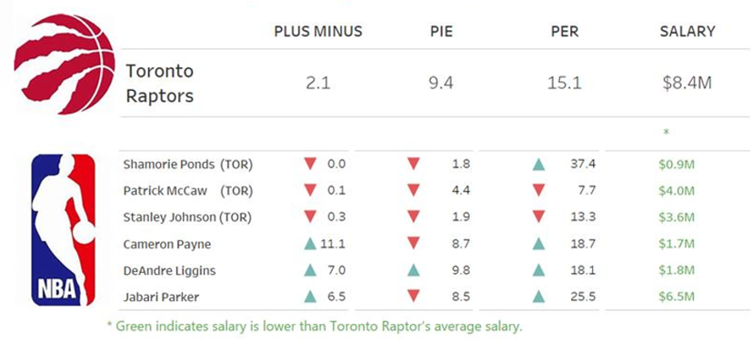
Data Analysis Results – Phase 2
Player average stats comparison
Notes:
Here is the result for our Data analysis – Phase 2.
[NEXT 01 – API]
The top part is the player average stats for Toronto Rapotrors. In the analysis, we consider both regular season and playoffs. Based on data from season 2014-20, the average puls minus for Toronto Raptor is 2.1, PIE is 9.4 and PER is 15.1. The average salary is around $8.4M.
[NEXT 02 – Player Game Logs]
Based on the stats, 3 underperforming Toronto Raptors players were selected for season 2019-20.
[NEXT 03 – Play by Play]
Now we used the average stats to select the replaced players for NON-TORONTO teams. The selection is to use PLUS_MINUS>2.1, 5<PIE<10, as we know the TOP players are not obtained, PER>15.1, and salary<8.4M.
Here is the selection for NON-TOR players.
[NEXT 04 – Player salaries]
From the graph, the red triangle means the decrease, the blue triangle means the increase. All the players’ salary is below $8.4Million. They were highlighted in green.
[NEXT SLIDE]

Slide 13
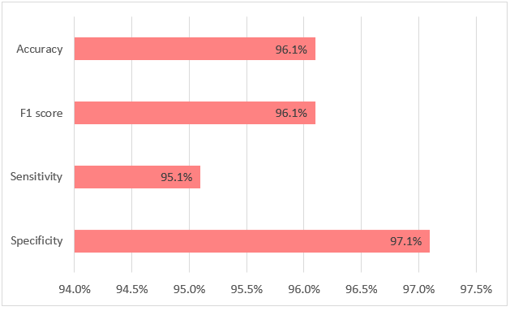
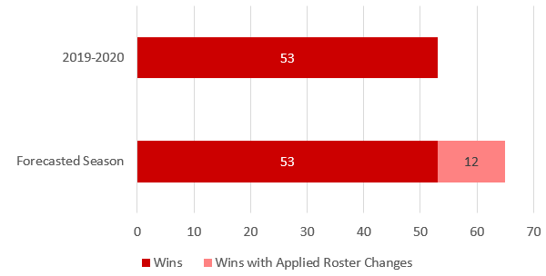
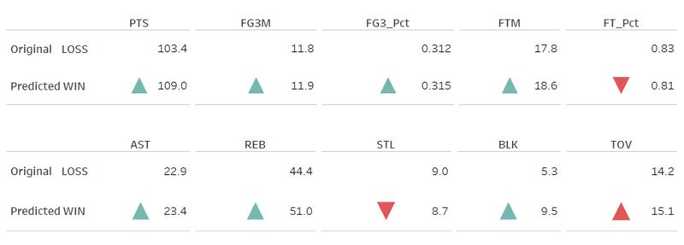
Results – Team Win Prediction
Projected Wins
Model Performance
Performance Improvement
Notes:
[Next speaker - Dennis]
Our tuned Random Forest Model provided
[NEXT 01 – Model stats]
analysis results around the mid 90 percentage.
[NEXT 02 – Graph Win prediction]
Assuming the same number of games in a regular season (72),
[NEXT 03 – Graph Win prediction]
the model predicted a 23% or 12 win increase over the previous season
[NEXT 04 – Team stats]
Taking a closer look at these 12 games, we found an improvement in 7 of the 10 team statistics. Looking more closely at the decreased performance statistics
[NEXT 05 – Bad team stats FT%]
Decreased performance in Free-Throw % was countered with
[NEXT 06 – Counter bad team stats FT%]
increased Free-Throw opportunities which points were gained. Any decrease in possession (meaning the team’s ability to control the ball)
[NEXT 07 – Bad team stats STL/TOV]
from steals or turnovers was countered with improvements in
[NEXT 08 – Good team stats]
assists, rebounding, and shot blocking by a ratio of 1 loss of possession to 5 gains in possession
[NEXT 09 – PTS]
The main result is the team was able to score on average 5 more points per game for these 12 wins.
[NEXT SLIDE]

Slide 14
Recommendations
Identify high potential players by focusing on PLUS_MINUS, PER, and PIE
Field Goal % (FG_PCT) and 3-pointers % (FG3_PCT) for player efficiency
Player selection based on
Maximizing the utilization of underutilized players with higher stats
Important feature values > TOR player
Salary < TOR player
Notes:
For improvements to the TOR roster,
[NEXT 01 – Search]
the organization is to look at Non-TOR players with
[NEXT 02 – Main Features]
higher feature values in PLUS_MINUS, PER, and PIE compared to their current roster. These statistics hold potential values in producing team wins and are underutilized by their current teams.​
[NEXT 03 – FG and FG3%]
We can also examine Field Goal % (FG_PCT) and 3-pointers % (FG3_PCT) which would provide more efficient offensive players
[NEXT 04 – Criteria]
When narrowing the search criteria of Non-TOR players, we recommend players with higher important feature values than the average Toronto player and a salary below the Toronto player average.
[NEXT 05 – Player underutilization]
Lastly we advise further investigate of an underutilized selected TOR player. In either case the team should either use him or replace him.
[Next speaker handoff - Cindy]
[NEXT SLIDE]

Slide 15
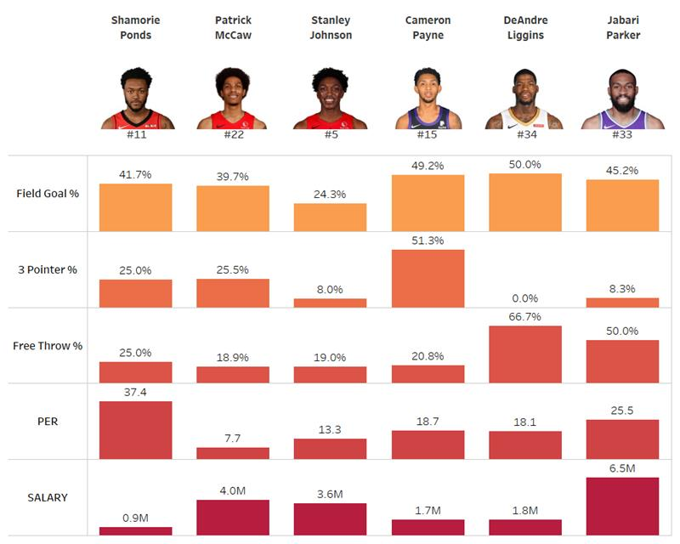
Players Evaluation
TOR
Notes:
[NEXT 01 – key statement for animation]
Let’s take a look at the play stats to evaluate their performance.
On this graph, 6 players were listed. The first 3 are the currently Toronto Raptors players. The last 3 are the selected replaced players.
[NEXT SLIDE]
For the field goal%, the replaced players hold the higher field goal% percent than TOR players.
For the 3 pointer%, Cameron is the best and shot 50% of the attempts.
For the free throw%, DeAndre holds 66.7% rate.
There is an evidence of underutilization of a selected TOR player (Shamorie Ponds). Mr. Ponds had a very high PER, and he only attended 4 games. Overall his performance is under the average.
We advocate exploring his utilization or replacing him.
All the players are under $8.4M for the contract.

Slide 16
Limitations
Toronto Raptors only
Qualitative factors
Health
Rapport with the team
Satisfaction with the coaching
Placement in the games
Happiness with the contract
Personal life
Notes:
[Next speaker - Dennis]
There are limitations to our analysis / recommendation
[NEXT 01 – TOR only]
This analysis is limited to Toronto Raptors only. As the teams change, the important features for those teams can sway.
[NEXT 02 – Qualitative factors]
There are qualitative factors that affect the performance of a player and are beyond the scope of this project. These include but are not limited to the player’s:
[NEXT 03 – Qualitative factors List]
Health (physical and mental)
Rapport with the team
Satisfaction with the coaching
Placement in the games (having sufficient playing time)
Happiness with the contract
Personal life
And the list can go on.
[NEXT SLIDE]

Slide 17

THANK YOU
Notes:
This concludes our presentation.
Are there any questions?
Are there any ideas or suggestions?

Slide 18
BLANK Delete everything from this slide onwards

Slide 19
Reference Instructions
Cover: Informative title, team number and member names
Provide a brief background of organization/problem addressed.
Business problem/opportunity (stakeholder, challenge/opportunity, humanity considerations)
Data mining problem (supervised/unsupervised, explanatory/predictive, how to be deployed)
Data description
Data cleansing, if needed – steps taken – what were the challenges with the data and steps taken to cleanse bring it to usable format (ETL – extract, transform, load steps). Technology/tools used for cleansing/analysis
Methods (methods, relevant outputs)
Evaluation (metrics of interest, benchmark, comparison)
Implications – so what can business/org do with findings/actions
Recommendations (what should the client be aware of? problems you encountered, suggestions for future data collection or analysis, etc.)
Notes:
[NEXT 01 – Feature Importance]
We had each model determine feature importance. For comparison purposes, we simply took the top 10 features as determined by each model. Focusing on our favored models
[NEXT 02 – Forest]
(center
[NEXT 03 – Logistic]
and right) these models have 3 features in common in the top 5 which are PLUS_MINUS, SEASON_YEAR_code, 3Pts FG% (FG3_PCT) .
As preliminary recommendation the Raptors’ game outcomes are impacted by players with high PLUS_MINUS and 3Pts FG% (FG3_PCT) Simply means you score more efficiently, you win games but we will need to better understand if SEASON_YEAR_code is an acceptable feature to keep. This may all change as we tune the models.
[NEXT SLIDE]

Slide 20
[Template - Insert Title]
Notes:
[name to take over,]
Thank you, [Insert name]. Hello all, this is [Insert name]. I will continue to talk about [Insert next subject].
Thank you [Insert name]. I will continue on to the next part of [Insert next subject].
[NEXT 0x – key statement for animation]
[Speaker’s talking points on the current slide item]
[Next speaker handoff statement]
Now I shall hand off to [Insert name]
[NEXT SLIDE]

Slide 21
Limitations
Toronto Raptors only
Qualitative factors
Health
Rapport with the team
Satisfaction with the coaching
Placement in the games
Happiness with the contract
Personal life
Notes:
This analysis is limited to Toronto Raptors only. As the teams change, the important features for those teams can sway. There are qualitative factors that affect the performance of a player and are beyond the scope of this project. These include but are not limited to the player’s:
Health
Rapport with the team
Satisfaction with the coaching
Placement in the games
Happiness with the contract
Personal life
There is a player selected to be replaced on the Toronto roster. Ponds who is new to the roster with only 4 regular season games is seen as a low-value player in terms of PLUS_MINUS and PIE but has a very high PER. This mainly is due to a lack of usage, but additional data is required.
[NEXT 0x – key statement for animation]
[Speaker’s talking points on the current slide item]
[NEXT SLIDE]

Slide 22
Recommendations
Search for Non-TOR players with
Higher feature values in Plus/Minus, PER, and PIE compared to their current roster. ​
Field Goal % (FG_PCT) and 3-pointers % (FG3_PCT) for player offensive efficiency.
Non-TOR players selection higher important feature values than the average TOR player and a salary below the average of a TOR player.
There is an evidence of underutilization of a selected TOR player. We advocate exploring his utilization or replacing him.
Notes:
For improvements to the TOR roster,
[NEXT 01 – Search]
the organization is to look at Non-TOR players with
[NEXT 02 – Main Features]
higher feature values in PLUS_MINUS, PER, and PIE compared to their current roster. These statistics hold potential values in producing team wins and are underutilized by their current teams.​
[NEXT 03 – FG and FG3%]
We can also examine Field Goal % (FG_PCT) and 3-pointers % (FG3_PCT) which would provide more efficient offensive players
[NEXT 04 – Criteria]
When narrowing the search criteria of Non-TOR players, we recommend players with higher important feature values than the average Toronto player and a salary below the Toronto player average.
[NEXT 05 – Player underutilization]
Lastly we advise further investigate of an underutilized selected TOR player. In either case the team should either use him or replace him.
[Next speaker handoff - Cindy]
[NEXT SLIDE]

